Slide 1
automation system using pi

Slide 2

Idea !
Soon, the will be the smartest room in a person's home.
The Internet of Things is a loosely defined concept that revolves around using the Internet to animate and coordinate objects and systems that were previously considered inanimate. One technology described the Internet of Things as a very near future filled with "tiny, intelligent things all around us, coordinating their activities.

Slide 3
Functioning
Add products by scanning qr code on products
The products would be automatically added to the database
We can access our products
We can modify details on usage
We can get notification of products related to their expiry date

Slide 4
Set-UP Procedure
Raspberry Pi – Basic Setup without Monitor and Keyboard (Headless Setup)
we will see how to setup the Raspberry Pi without monitor and keyboard. This type of setup is often called as Headless Setup of Raspberry Pi. Before going in to the details of the basic setup, let us take a brief look at the high performance single board computer – The Raspberry Pi.
Raspberry Pi is small pocket sized computer developed by the Raspberry Pi Foundation of the United Kingdom. Although the main reason for developing the Raspberry Pi series was to teach the basics of computer science and programming to the school students, the Raspberry Pi has reached in to a wider range of user like makers, hobbyists, electronics enthusiasts and even in the field of robotics.

Slide 5
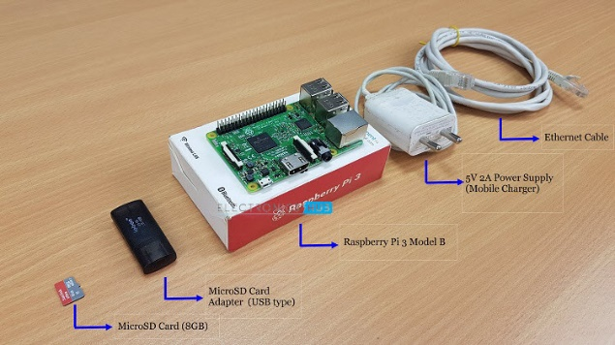
Hardware needed for Headless setup of Raspberry Pi
First, let us gather all the hardware components required for the setup. In order to setup the Raspberry Pi, we need the following components.
A Computer with Internet connection (Laptop or Desktop)
Raspberry Pi 3
5V – 2A Power Supply (Recommended by the Raspberry Pi) with microUSB connector
MicroSD Card (minimum 8GB)
SD Card Adapter (USB type or standard SD Adapter)
Ethernet Cable (in addition to the one used for computer)
Access to the internet router (if no access, do not worry, we have an alternative)

Slide 6
